Slide 1
Disrupting Academic Bullying
An Initiative by the Graduate School at Virginia Tech

Slide 2
What is Bullying?
Intentional behavior targeted at an individual or group that is repeated, hostile or offensive, and creates an intimidating and/or threatening environment which produces a risk of psychological and/or physical harm.

Slide 3
Forms of Bullying*
Indirect manipulative aggression: Aggressive acts involving a peer group such as spreading rumors or isolating someone from their group.
Covert insinuative aggression: When the aggressive act is disguised in the form of malicious insinuations and suggestions such as imitating the person in an insulting manner.
Rational–appearing aggression: Characterized by the bully’s attempt to conceal their intention to hurt the victim by shrouding their aggressive acts in seemingly rational actions. Often these acts appear to others as everyday communication and not as targeted attempts at aggression.
Relational Aggression: The point of relational aggression is to manipulate or disrupt relationships and friendships.
Mobbing: Gang bullying or group bullying is often called mobbing and usually involves scapegoating and victimization.
* From: Morris, J. (2014) . The Influence of Bystanders in Subsequent Bullying Behavior.

Slide 4
Defining the Roles
Directly involved
Target: Someone against whom mistreatment is directed.
Aggressor: Someone who repeatedly and consistently says or does something harmful or malicious to another person.
Observers
Passive bystander: Someone who sees something happening and does not say or do anything.
Active bystander/Upstander: Someone who speaks out on behalf of someone else or takes actions that are supportive of someone else.

Slide 5
Identifying Bullies*
Chronic: Those who use aggressive, dominating, and coercive strategies in nearly every encounter in and out of work/classroom.
Opportunist: Those who suspend their aggressive behavior outside of work but believe ‘careers are built with political gamemanship’.
Accidental: Those who unknowingly take actions that victimize recipients, and may retreat/apologize when confronted about the behaviors.
Substance-abusing: Those bullying behaviors initiated by substance abusers where ‘rationality and logic are tossed out the window’.
* From: Theiss, S. (2005). Bullying in Academia: What’s an Ombudsman to do?
Notes:
A further distinction to help determine proper intervention is to identify if the aggressor is a predatory bully or becomes a bully when triggered by disputes.

Slide 6
Bullying Behaviors
Continual threats of dismissal or intimidation.
Attempts to destroy or harm the person’s self-esteem or confidence.
Constant negative remarks or repeated criticism or sarcasm.
Consistent over time, unrealistic work demands, or work overloading.
Isolating or systematically isolating the person.
Spreading false information or rumors.
Tasks that are ambiguous, contradictory, or that are deprived of purpose.
False insinuations, attacks to the individual's dignity, integrity, or self-image.
Attempts to humiliate or public humiliation.
Notes:
Inquiry?
Reflect upon times when you observed or experienced academic bullying.
What behaviors could you identify?
How did you respond?
What would you have liked to do?
What would provide you support to take that action in the future?

Slide 7
Why Address Bullying Now?
Promote civility
Uphold Principles of Community
Increase productivity
Decrease absenteeism/disengagement
Model constructive group dynamics
Influence higher morale
Notes:
Inquiry?
What are some further reasons to address academic bullying?
What factors exist that deter the disruption of academic bullying?
How can we overcome the challenges these factors present? (Education, awareness, consistent modeling)

Slide 8
Institutional Factors that Foster Bullying
Inherent power differentials within academic institutions
Proliferation of disrespectful communication styles
Focus is on development of specialized knowledge
Competition for finite resources
Notes:
Inquiry?
- What other institutional factors create an environment conducive to bullying behaviors?

Slide 9
Disrupting Bullying as a Target
Procedural
Seek allies
Approach a higher level of authority
Submit a report
Reach out to Ombudsperson to navigate process
Self-care
Find outlets to reduce stress
Build your professional network
Strengthen identity outside of work
Consider support from mental health professionals

Slide 10
Disrupting Bullying as a Bystander
In the moment
Acknowledge that you are witnessing behavior that qualifies as bullying.
Ask the target if they would like assistance.
Shut down bullying behaviors in group situations.
Follow-up action
Reach out to the target of the bullying behavior.
If appropriate, speak to the aggressor in private about their behavior.
Know the resources available for the target and yourself.
Submit a report via this referral form.

Slide 11
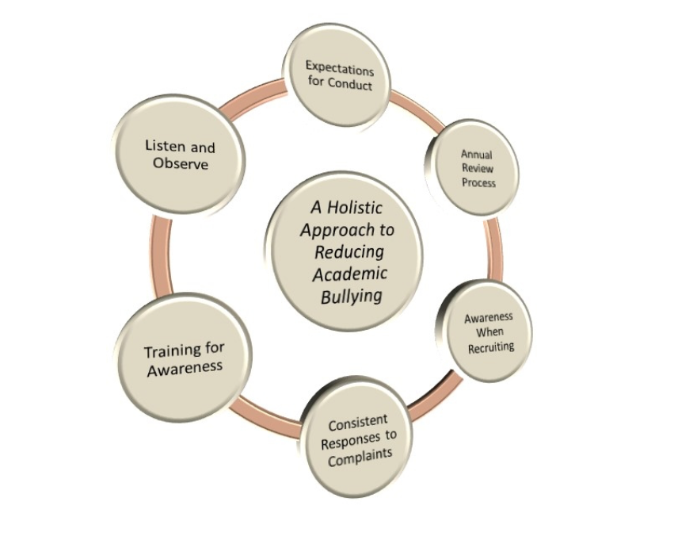
Disrupting Bullying as a Leader
Directly
Listen and Observe
Consistent Response to Complaints
Annual Review Process
Indirectly
Set Expectations for Conduct
Awareness when Recruiting
Train for Awareness
Notes:
Inquiry?
What are some actions you can take in your environment to help disrupt academic bullying?
What level of support would assist you in taking these actions?

Slide 12
Resources Available
Disrupting Academic Bullying Website
https://graduateschool.vt.edu/student-life/we-hear-your-voice/disrupting_academic_bullying.html
Academic Bullying Referral form
https://virginiatech.qualtrics.com/jfe/form/SV_3gR6CDbKkf6OrtP
Cook Counseling
https://ucc.vt.edu/
Equity and Access
https://oea.vt.edu/about/requesting-assistance.html
Office of Inclusion and Diversity
https://www.provost.vt.edu/who_we_are/inclusion_diversity.html
Dean of Students
https://www.dos.vt.edu/
Ombudsperson
https://graduate.ombudsman.vt.edu/

Slide 13
Cases for Reflection
Cases available for reflection on website:
https://graduateschool.vt.edu/case-studies-academic-bullying
Notes:
Inquiry for cases?
How does this case resonate with your experiences at Virginia Tech?
How would you respond to this situation?
What level of support would allow you to move forward in a positive direction?

